Slide 1



BOOKS
View in Power BI
Last data refresh:
11/21/2023 7:17:59 PM UTC
Downloaded at:
11/21/2023 7:42:28 PM UTC

Slide 2
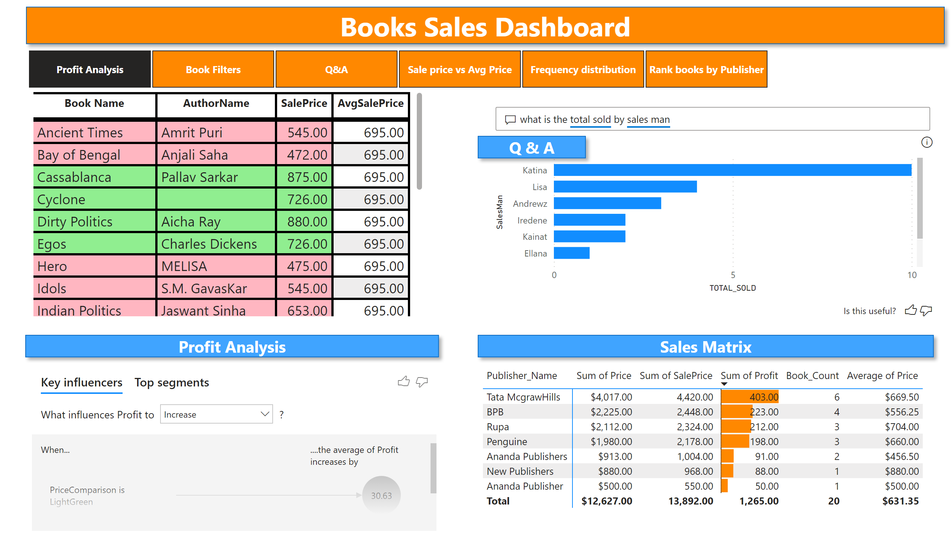
Profit Analysis
Notes:
shape
No alt text provided
shape
No alt text provided
qnaVisual
No alt text provided
keyDriversVisual
No alt text provided
shape
No alt text provided
pivotTable
No alt text provided
tableEx
No alt text provided
shape
No alt text provided
pageNavigator
No alt text provided

Slide 3
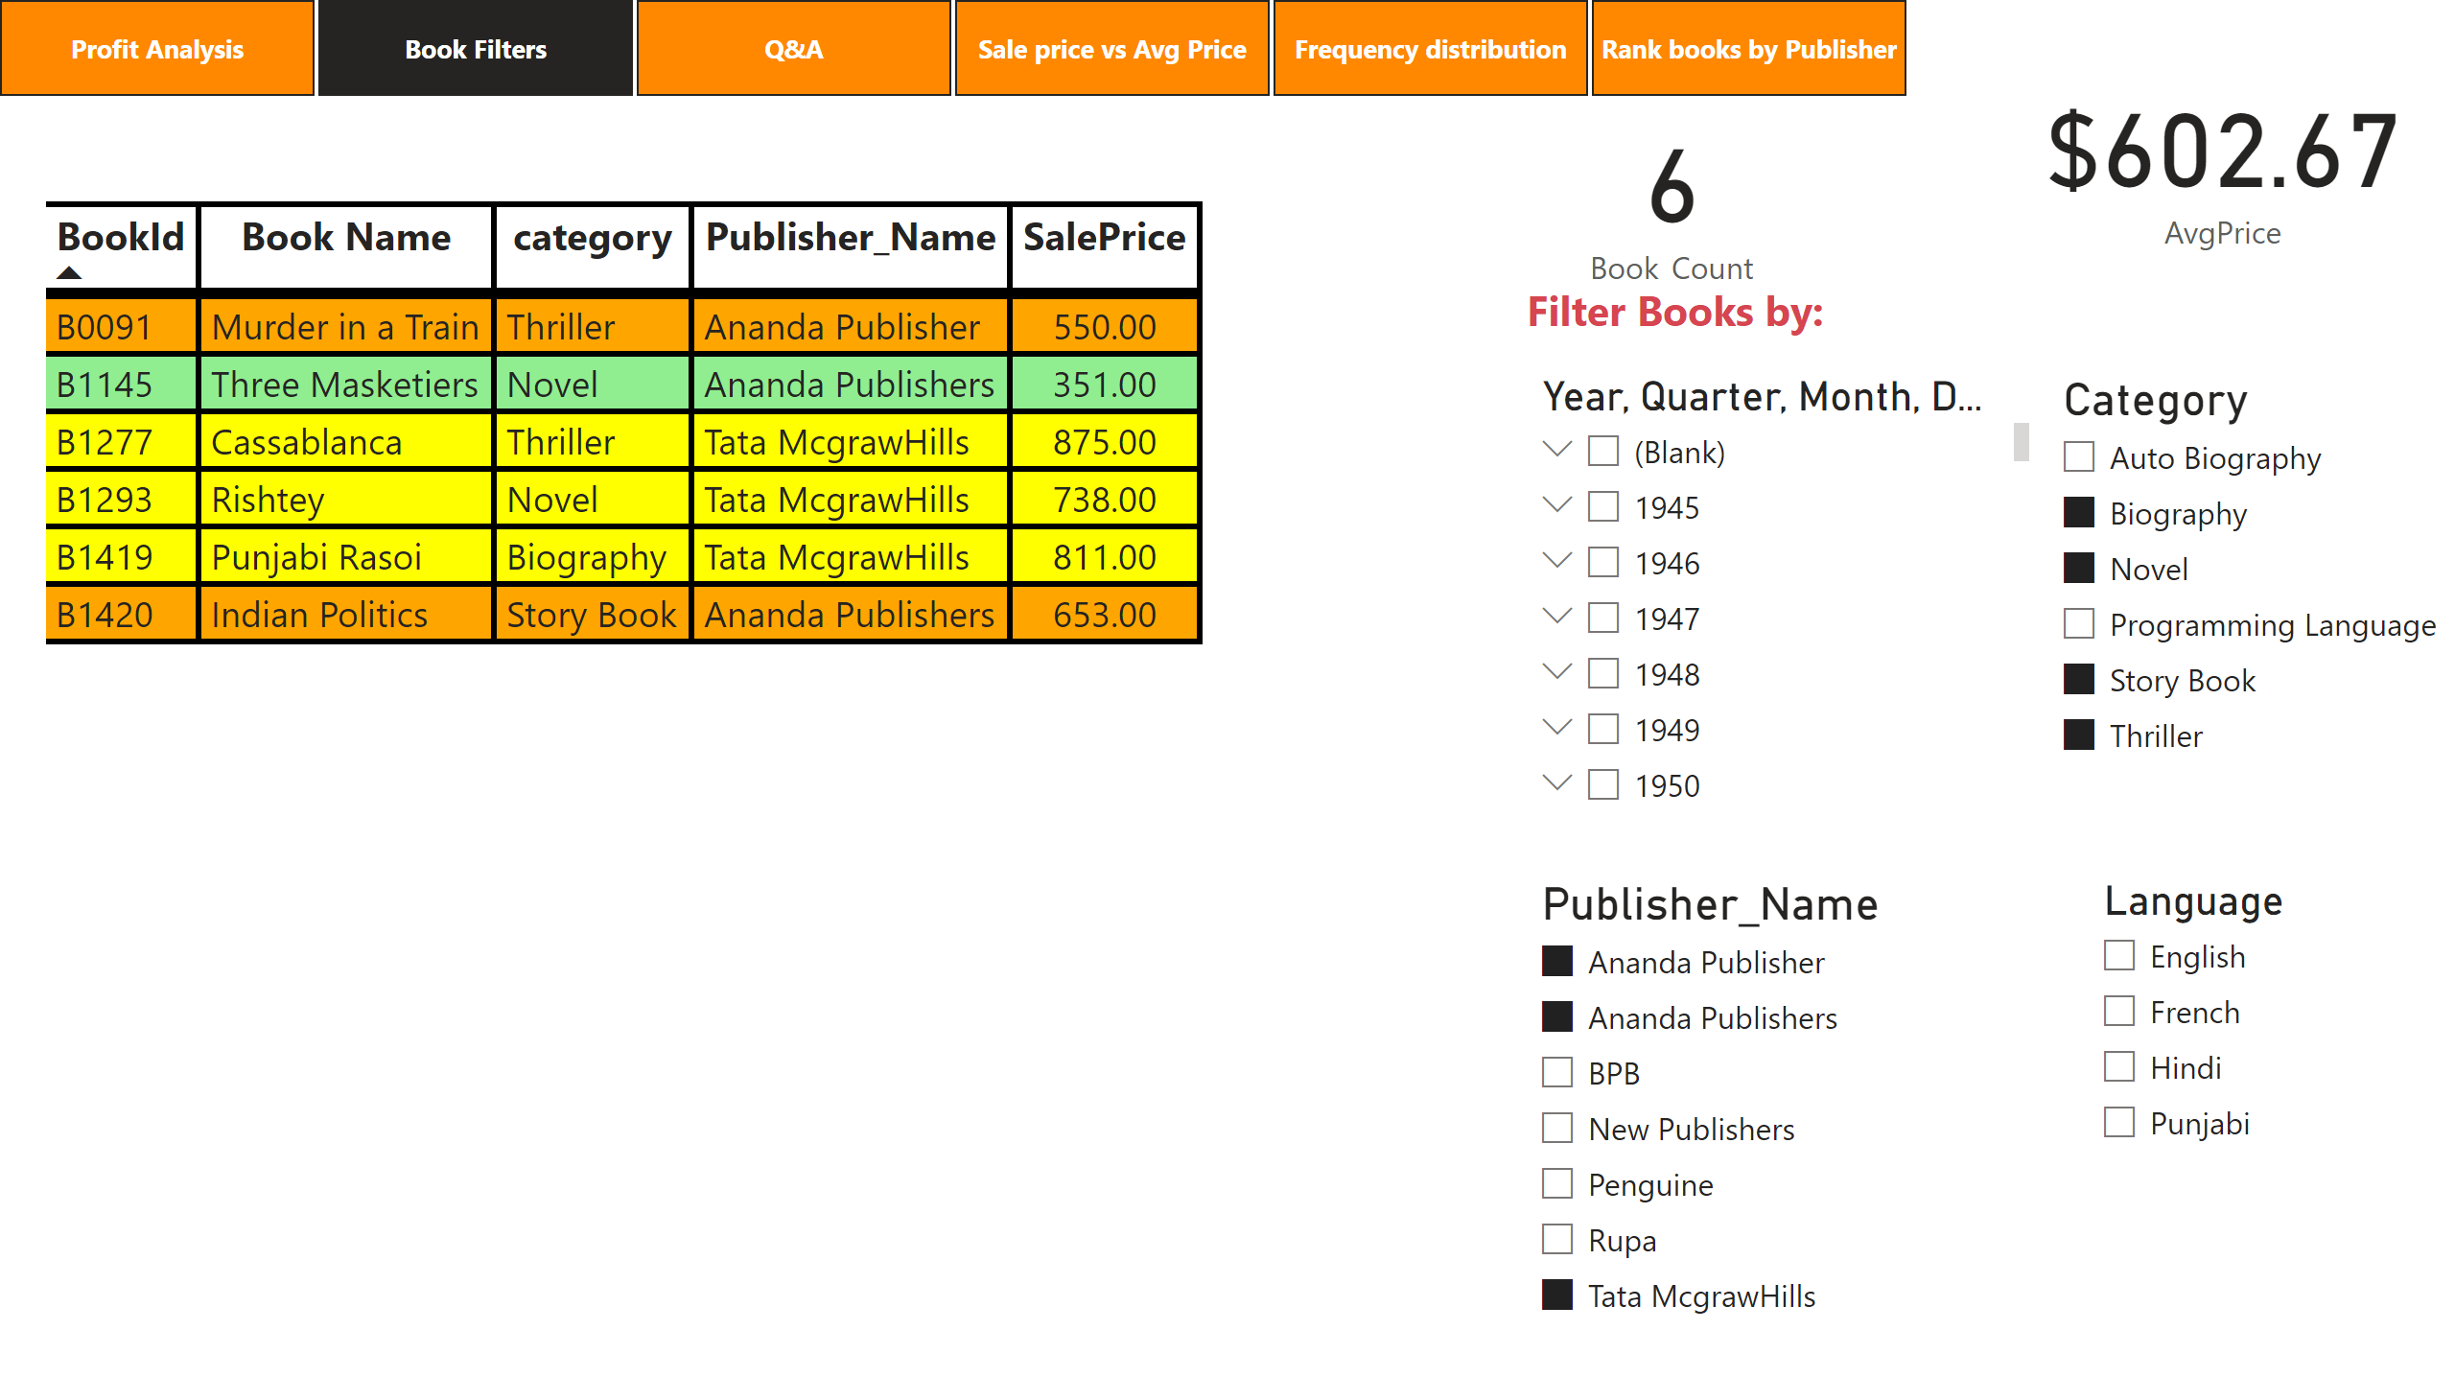
Book Filters
Notes:
tableEx
No alt text provided
textbox
No alt text provided
card
No alt text provided
card
No alt text provided
slicer
No alt text provided
slicer
No alt text provided
slicer
No alt text provided
slicer
No alt text provided
pageNavigator
No alt text provided

Slide 4
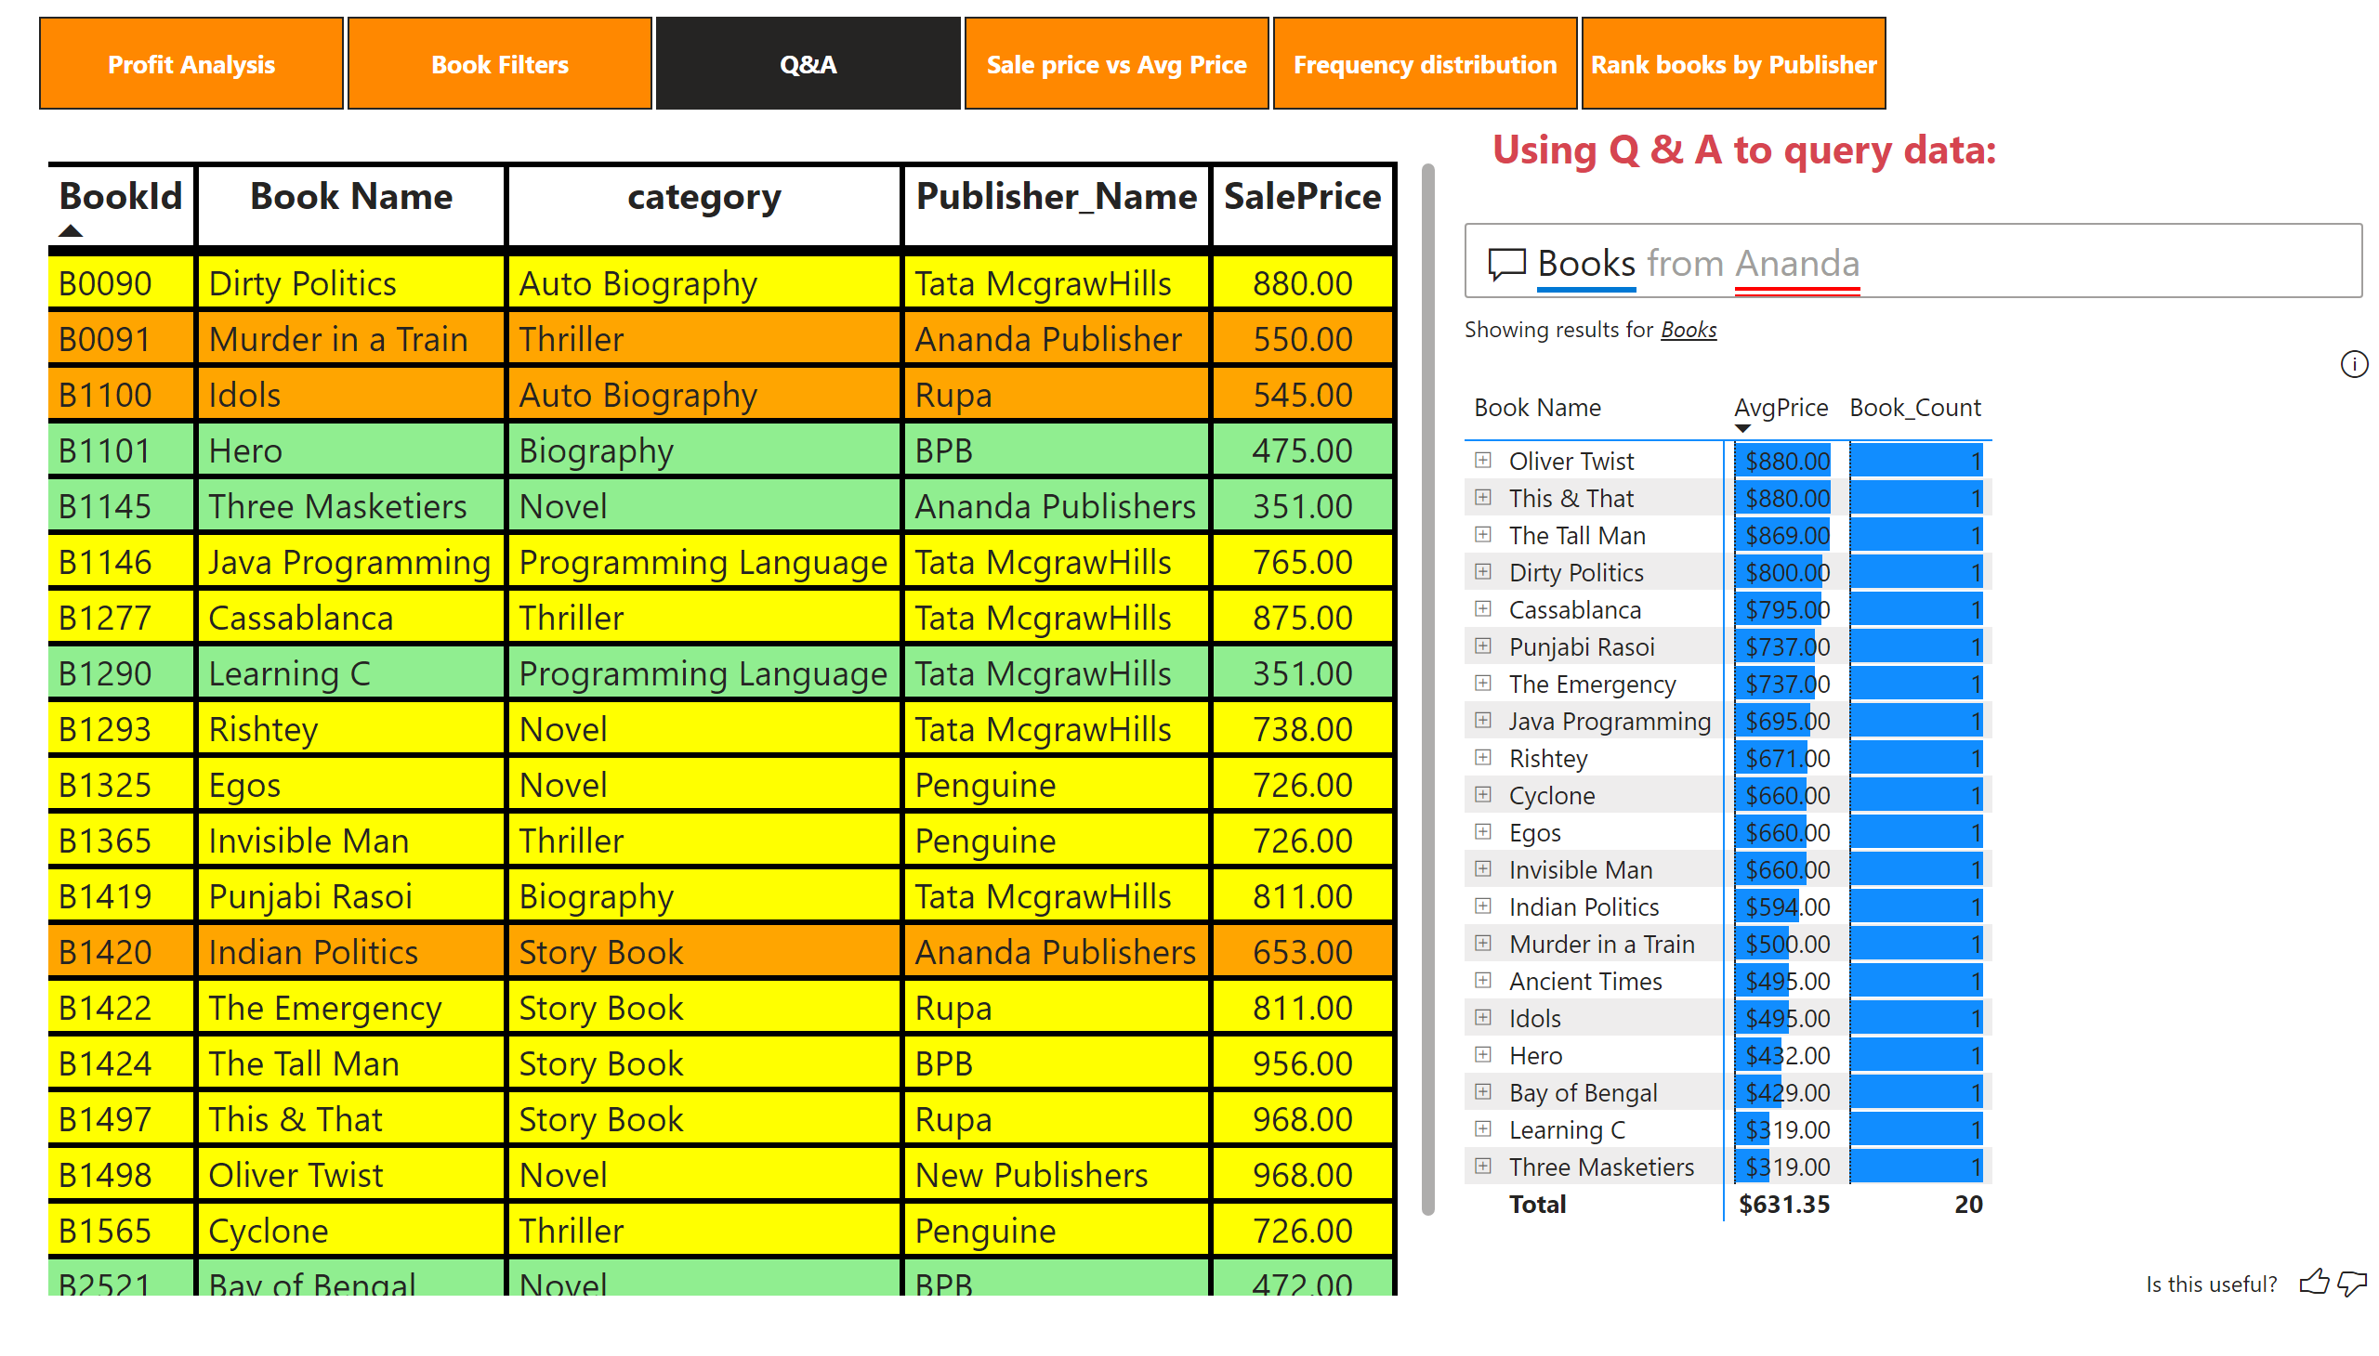
Q&A
Notes:
tableEx
No alt text provided
textbox
No alt text provided
qnaVisual
No alt text provided
pageNavigator
No alt text provided

Slide 5
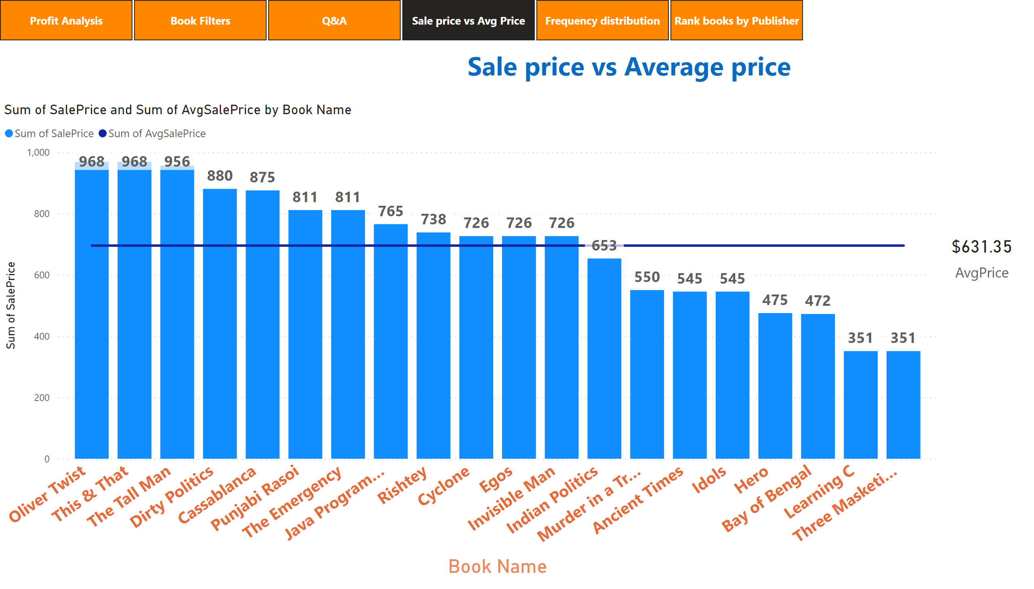
Sale price vs Avg Price
Notes:
lineStackedColumnComboChart
No alt text provided
card
No alt text provided
textbox
No alt text provided
pageNavigator
No alt text provided

Slide 6
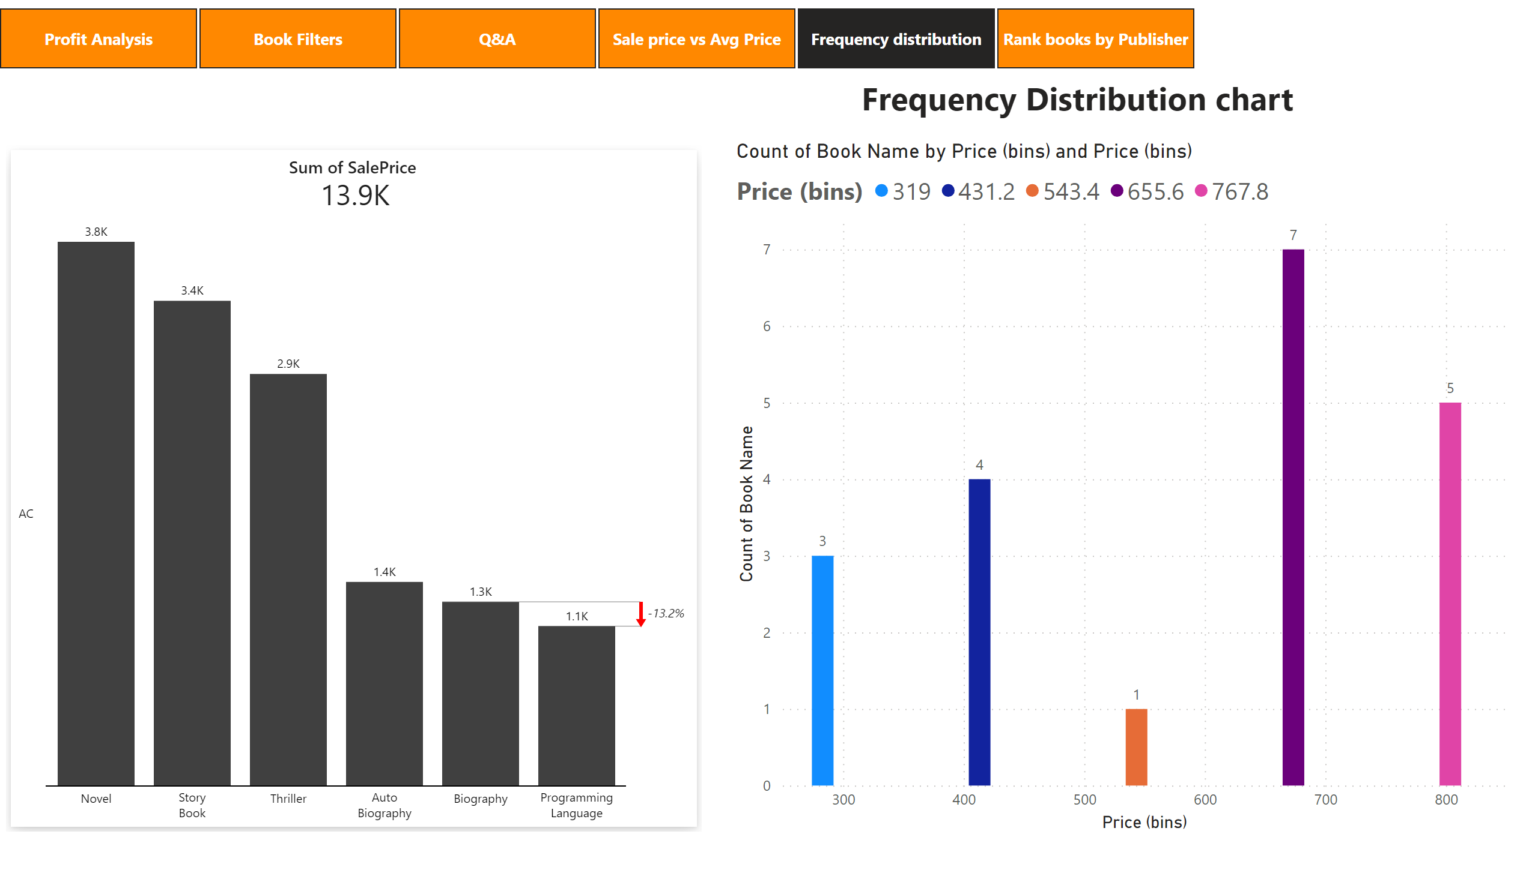
Frequency distribution
Notes:
zebraBiCards2C860CFAA9944091B75F0DBD117F20FA
No alt text provided
clusteredColumnChart
No alt text provided
textbox
No alt text provided
pageNavigator
No alt text provided

Slide 7
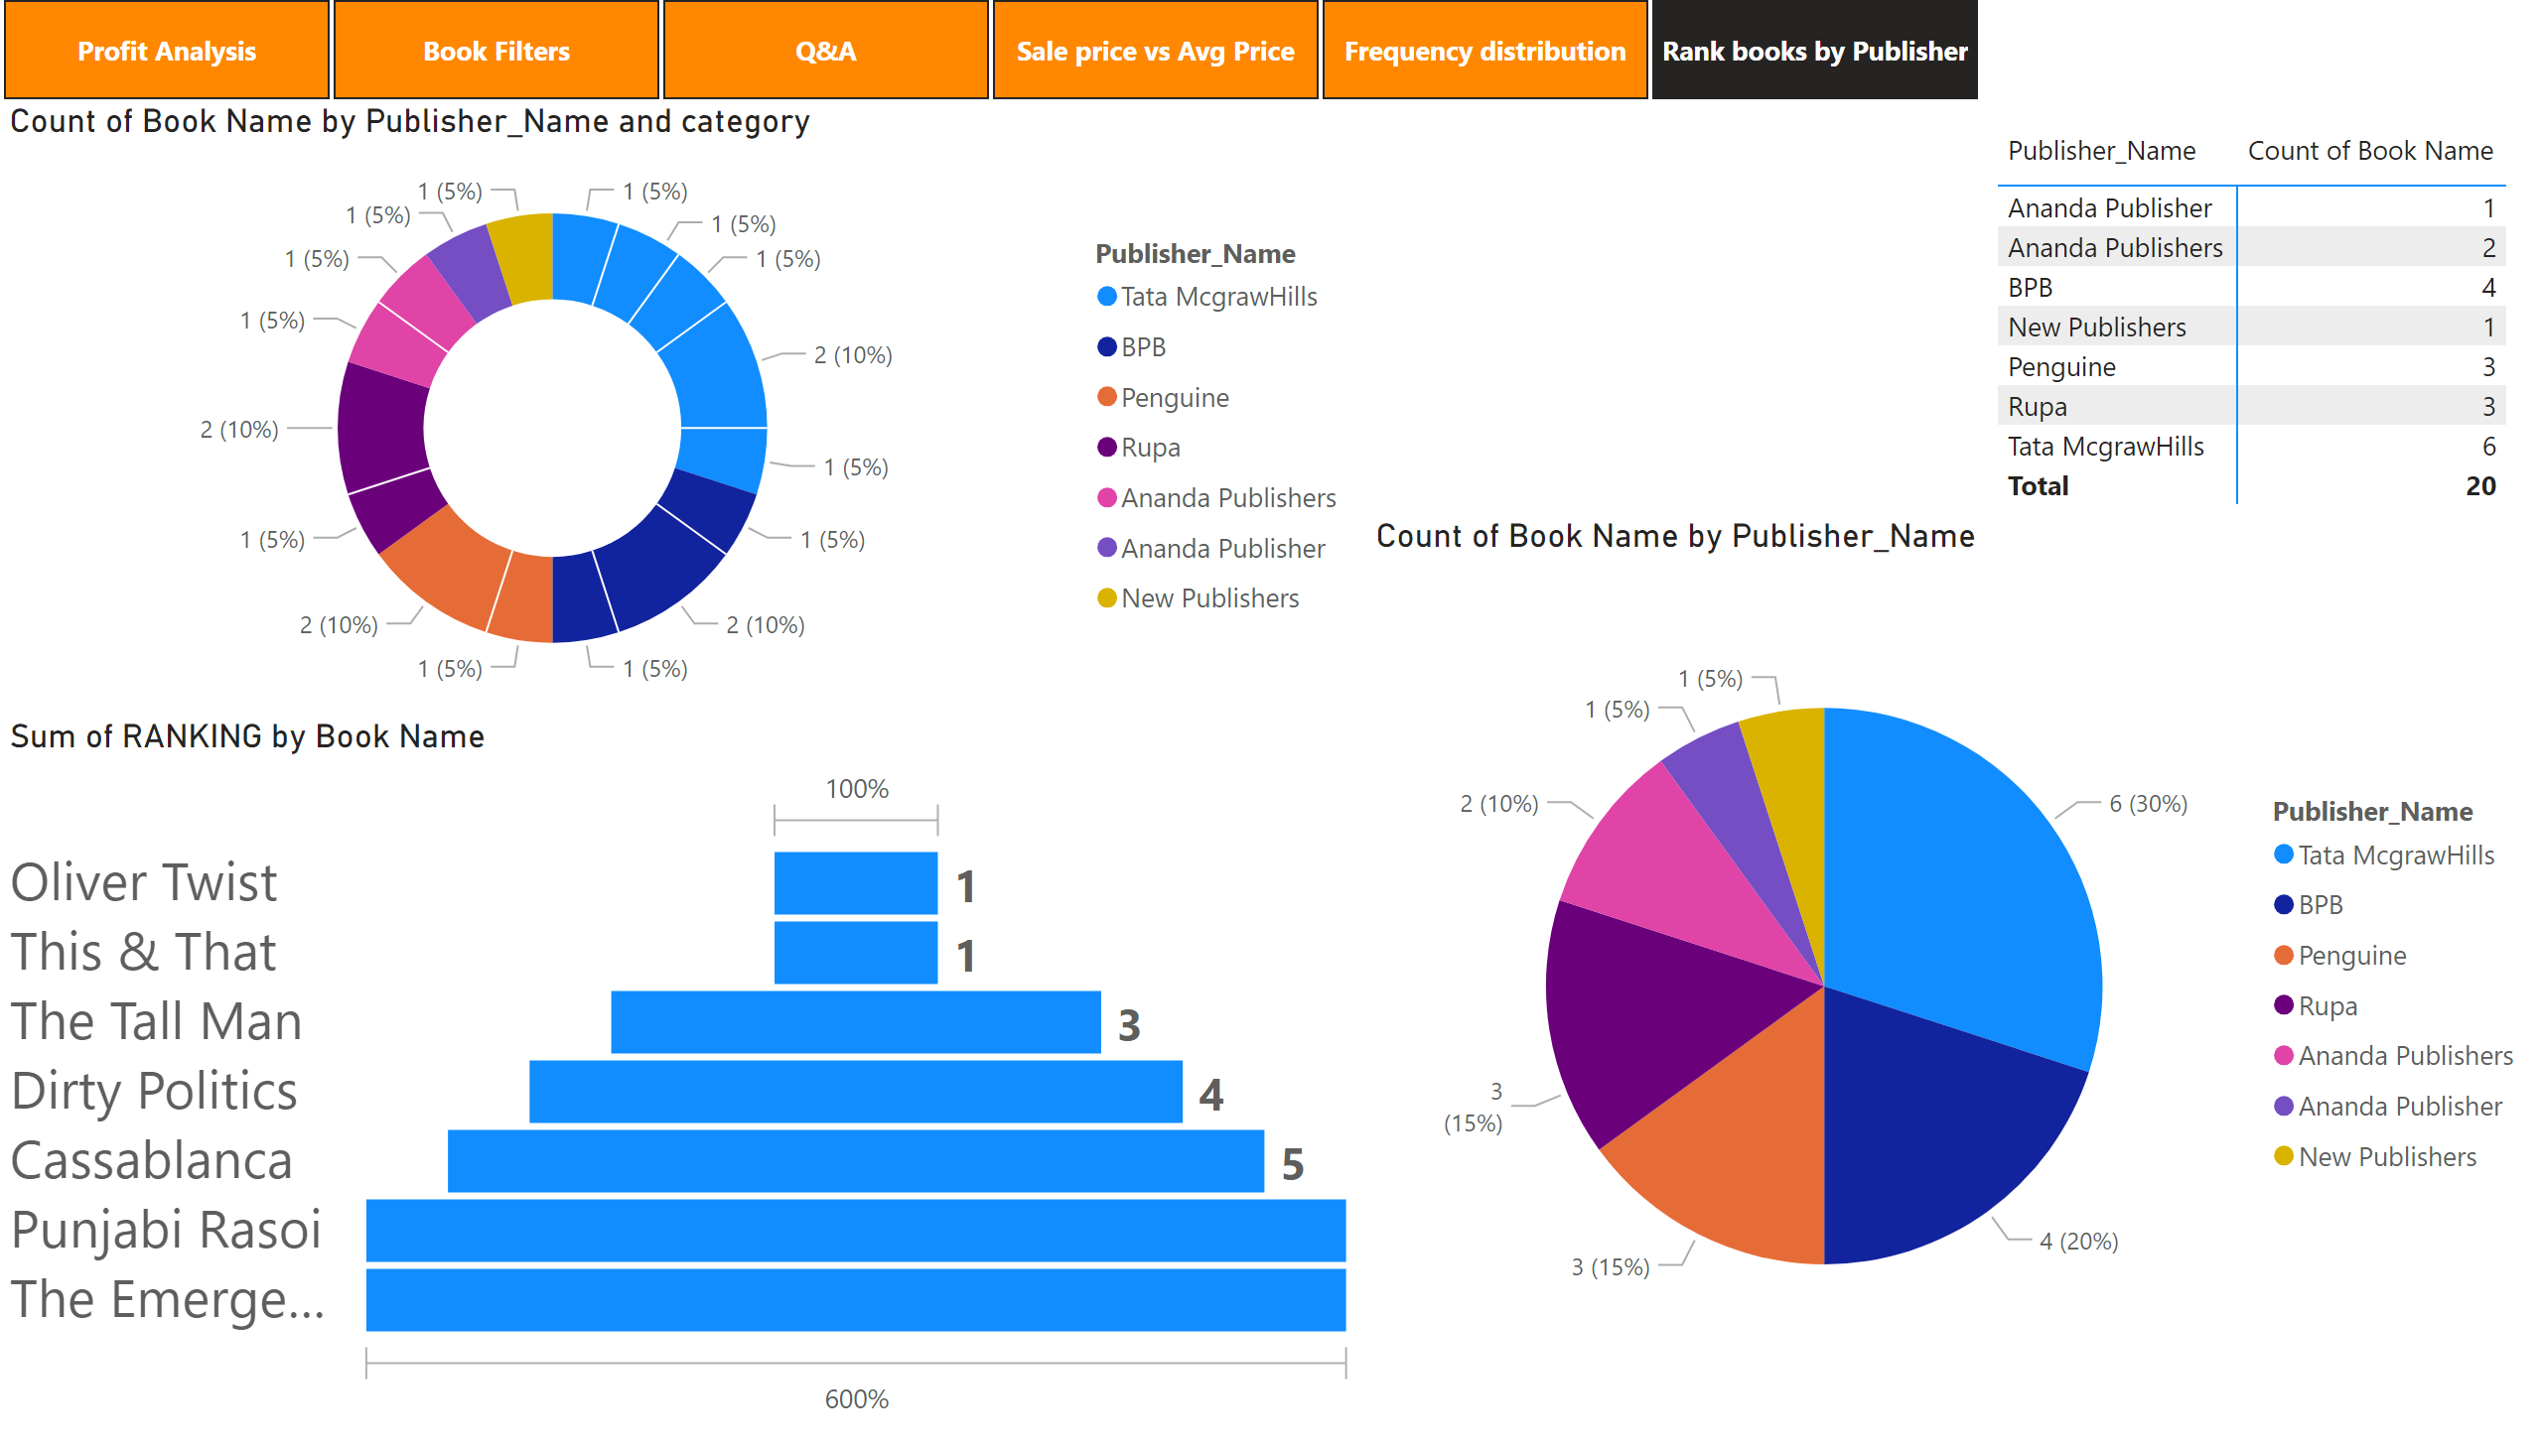
Rank books by Publisher
Notes:
pivotTable
No alt text provided
pieChart
No alt text provided
donutChart
No alt text provided
funnel
No alt text provided
pageNavigator
No alt text provided

